Slide 1
Climb Your Way to the Model: Teaching UML to Software Engineering Students Teaching case
Naomi Unkelos-Shpigel^{1,2}, Julia Sheidin^{1,2}, Moran Kupfer²
¹Software Engineering department, Ort Braude College, Karmiel, Israel
²Information Systems department, University of Haifa, Haifa, Israel
naomius, julia, moran@braude.ac.il
Unkelos-Shpigel, N., Sheidin, J., & Kupfer, M. (2019, June). Climb Your Way to the Model: Teaching UML to Software Engineering Students. In International Conference on Advanced Information Systems Engineering (pp. 40-46). Springer, Cham.

Slide 2
Motivation
Software-modeling courses are an integral part of IS and SE degrees curricula.
Challenges:
Extended practice is needed to fully understand the models
The teaching method is traditionally frontal, hence the instructor cannot get a clear picture of students` perceptions, and in particular, their misconceptions
UML diagrams usually consists of a large number of details, and several modeling variants are available

Slide 3
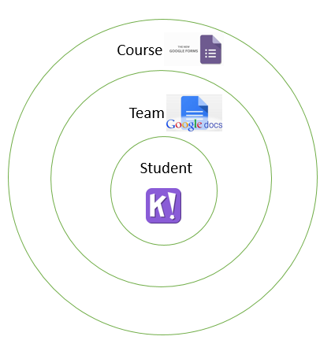
Background - Education
Flipped classroom (Jensen et al.,2015)
Peel The Union model (Unkelos-Shpigel, 2016)

Slide 4
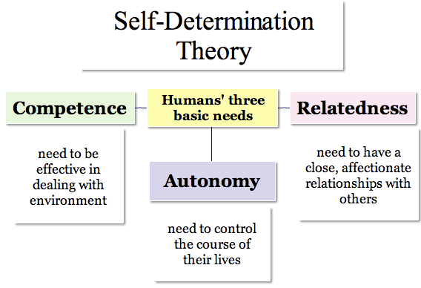
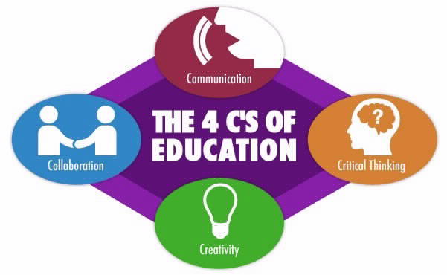
Motivation Theories
Self-determination theory (Ryan and Deci, 1985)
The 4C Model (National Education Association - Alexandria, 2012)

Slide 5
Guiding Questions
How can we promote software engineering students' achievements and participation in UML design courses?
What are the benefits of embedding active learning techniques in UML courses?

Slide 6
Case Study
SQA course, ~175 students from both CS and IS – 3rd semester, working in teams of 2, Course pre-requirements: Intro to System programming (advanced C programming language)
Lectures -3 weekly hours, tutorial -2 weekly hours
Assignments: 3 modeling assignments, in pairs

Slide 7
Case Study – Course Structure
Active learning task | Subject
Lecture: collaborative task – software that failed Recitation: Data collection practice – pairs | Requirement engineering methods | 1
Lecture: Use case modeling - pairs Recitation: Use case modeling - pairs | Use Case diagram | 2
Lecture: Activity diagram - pairs Recitation: Activity modeling - pairs | Activity diagram | 3
Lecture: Use case modeling and Class – pairs Recitation: Class modeling - pairs | Class diagram | 4
Lecture: Class and sequence diagram - pairs Recitation: Exam questions solving, and peer review – individuals | Sequence diagram | 5
Lecture: Statechart diagram - pairs Recitation: Statechart modeling - pairs | Statechart diagram | 6

Slide 8
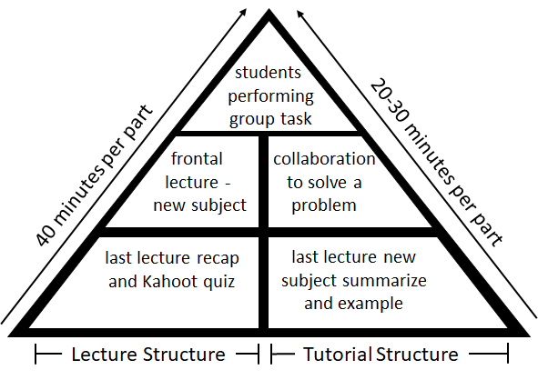
The Two-Way Climb Model

Slide 9
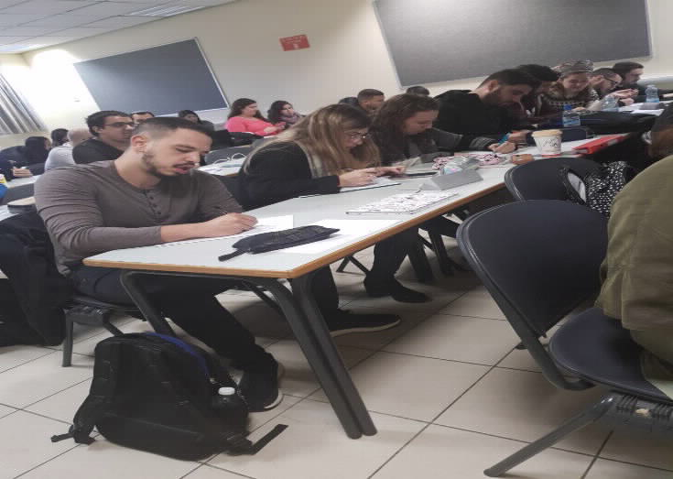
4Cs Model
Students were treated as creators and communicators, responsible for dealing with new and complex problems by teamwork.
Students were also collaborators, as they changed teams each class.
Students were critical thinkers, as we asked them to refer to other students’ work from the previous lecture.

Slide 10
Self-Determination Theory
We also provided them with conditions for the three basic needs of SDT:
They worked on each exercise with little instruction (autonomy),
They worked in small teams and helped each other to understand the task (relatedness),
They dealt with tasks that were more challenging than what they learn during the frontal class (competence).

Slide 11
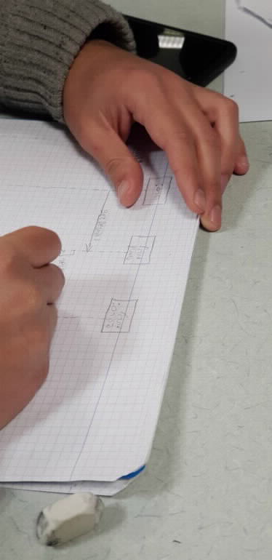
Team Level - Class Assignments
Teams were given an assignment on each lecture and tutorial
All students worked using personal computer
Several groups continued to work after the end of the class

Slide 12
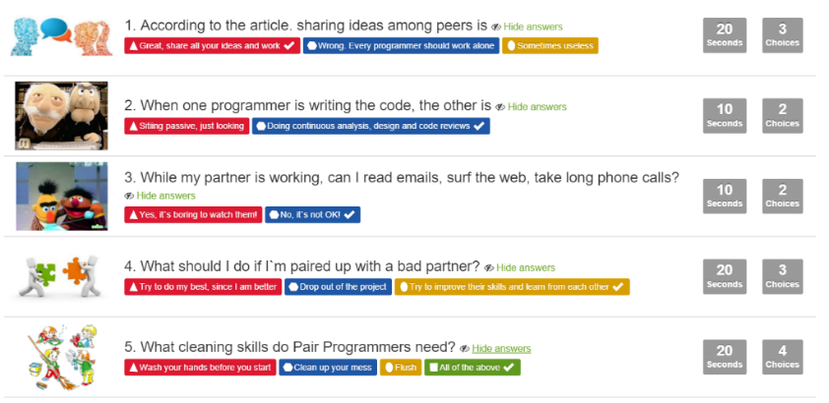
Student Level - Kahoot!
Short quiz at the beginning of the lecture
Almost all students present participated

Slide 13
Summary Survey
SDT | 4C's | Quote
✓ | ✓ | The activities helped me to develop a technique for modeling
 | ✓ | Reviewing my peers was useful, as I understood how much time to spend on a question, and how to plan the solution
✓ |  | I learnt from both my correct and incorrect solutions
✓ | ✓ | The class activities helped me realize that every student has his unique way to solve the problem
 | ✓ | The class activities encouraged me to look at the problem from different perspectives

Slide 14
RQ1- Findings
Student attendance
Solutions complexity
Students as thinkers, teachers as mentors

Slide 15
RQ2- Findings
Activities cs. Kahoot
70% of the students this semester thought they were redundant.
72% of the students said the class activities were helpful for their learning.
Promoters of iterative work and team work –
55% of the students felt that the tasks they performed helped them to enrich their knowledge each week.
70% of the students felt that team work was better than solving the task on their own.

Slide 16
Conclusions and Future Work
Improving students' achievements.
Increasing the participation and motivation during the semester.
The workload students face needs to be more balanced throughout the semester.
personal feedback following each assignment is in order.

Slide 17
THANKS!
Naomi Unkelos-Shpigel
E-mail: naomiu@is.Haifa.ac.il
Site: https://sites.google.com/site/naomiushpigel/home

