Slide 1
Contextualised MALL Comparison of Chinese Learning Activities Based on Country (Target/Non-Target) and Language Learning Orientation (Generic/Dedicated)
Anat Cohen, Orit Ezra

Slide 2
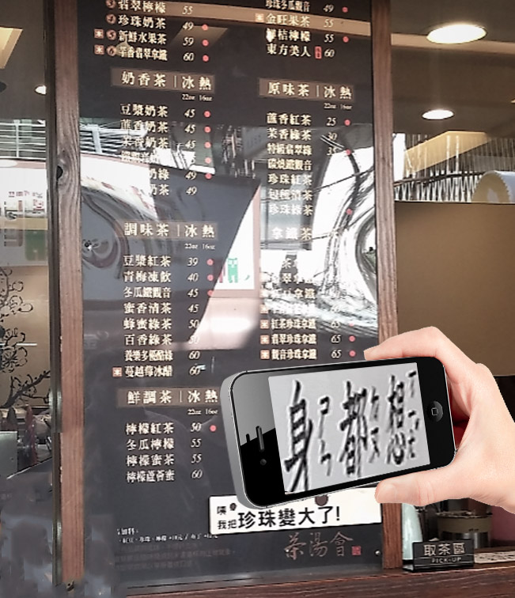
Presentation topics
1
Theoretical background
2
Methodology
3
Findings
4
Discussion and conclusions
5
Q&A

Slide 3
Introduction
1
Investigation of relations between variables and Mobile Assisted Language Learning (MALL) components are missing (Duman, Orhon, & Gedik, 2015)
3

Slide 4
Introduction
1
2
Investigation of relations between variables and MALL components are missing
(Duman, Orhon, & Gedik, 2015)
A consistent approach to constituents of contextualized MALL (CMALL) with a quantitative tool to evaluate it are missing (Burston, 2013; Burston, 2015)
3

Slide 5
Introduction
1
2
Investigation of relations between variables and MALL components are missing
(Duman, Orhon, & Gedik, 2015)
A consistent approach to constituents of contextualized MALL (CMALL) with a quantitative tool to evaluate it are missing (Burston, 2013; Burston, 2015)
3
Build a research framework for real world (RW) context level and real life (RL) context level
Build RW, RL context level evaluation index
3

Slide 6
Introduction
1
2
Investigation of relations between variables and MALL components are missing
(Duman, Orhon, & Gedik, 2015)
A consistent approach to constituents of contextualized MALL (CMALL) with a quantitative tool to evaluate it are missing (Burston, 2013; Burston, 2015)
4
3
Compare CMALL differences between target and non-target country (Taiwan/ Israel) and between language learning orientation (generic/dedicated)
Build a research framework for real world (RW) context and real life (RL ) context level
Build RW, RL context level evaluation index and context model
3

Slide 7
Introduction
Preliminary results are presented today
Cohen and Ezra, 2018
1
2
Investigation of relations between variables and MALL components are missing
(Duman, Orhon, & Gedik, 2015)
A consistent approach to constituents of contextualized MALL (CMALL) with a quantitative tool to evaluate it are missing (Burston, 2013; Burston, 2015)
4
3
Compare CMALL differences between target and non-target country (Taiwan/ Israel) and between language learning orientation (generic/dedicated)
Build a research framework for real world (RW) context level and real life (RL ) context level
Build RW, RL context level evaluation index and context model
3

Slide 8
Purpose of study
Explore variables that influence CMALL:
target country (Taiwan/Israel)
language learning orientation (generic/dedicated)
 | Taiwan | Israel
generic | RW context level – pertaining to one’s place, RL context level – pertaining to one’s life
dedicated
4

Slide 9
Research question
What are the differences between target and non-target country in CMALL?
1
What are the differences between generic and dedicated language learning orientation in CMALL?
2
Are the differences between target and non-target country in CMALL a function of the generic and dedicated language learning orientation?
3
5

Slide 10
Theory and literature review
1
CMALL definitions and evaluation - Real world context and real life context
Figure 1. Real world/real life CMALL model (Cohen & Ezra, 2018)
6

Slide 11
Theory and literature review
2.1
CMALL in target and not target countries
(Comas-Quinn et al., 2009)
Contextual language learning is ideally provided in the ‘target county’
However, mobile learning may provide alternative context-rich experiences in non-target countries
2.2
Mobile materials – dedicated and generic
(Reinders & Pegrum, 2016)
Dedicated restricted by the lack of knowledge in their scope of contexts (Reinders & White, 2010)
Generic materials on the other hand, such as social networks and video sharing, although not pedagogically pre-designed for learning, may offer active and collaborative learning (Reinders & Pegrum, 2016)
?
The question of whether learners actually turn real world or real life contexts into learning contexts arises
7

Slide 12
Purpose of study
3
Mobile Mandarin-Chinese learning
+
Importance of learning Chinese in context
Obstacles to learning Chinese in context
-
Chinese is difficult to learn (Moser, 1991)
Student level might not be sufficient for using contexts opportunities (Al-Mekhlafi, Hu & Zheng, 2009)
Learning in CMALL can promote transfer from one context to another (Klopfer, 2008)
Thus, the study is based on exploring Chinese learning activities
8

Slide 13
Study
Real world context level and real life context level
Based on Cohen and Ezra’s index (2018)
RW context values
Table 1. Real world context level statistic values
Table 2. Real life context level statistic values
RL context values
9
Notes:
I

Slide 14
Methodology – qualitative
Qualitative methodology * for establishing a quantitative evaluation of CMALL
Q1-3
Quantitative evaluation
Table 3. Learners, activities and events figures
Data collected by a structured interview
* Qualitative analysis detailed in Cohen and Ezra (2018)
10

Slide 15
Methodology – quantitative
A quantitative analysis (Q1-3)
A linear mixed-effects model was used to analyze activities (each student may have had a few activities)
Real world* and real life activity scores were calculated by averaging the respective scores of each event
* Total RW context (average of standardised scores)
11

Slide 16
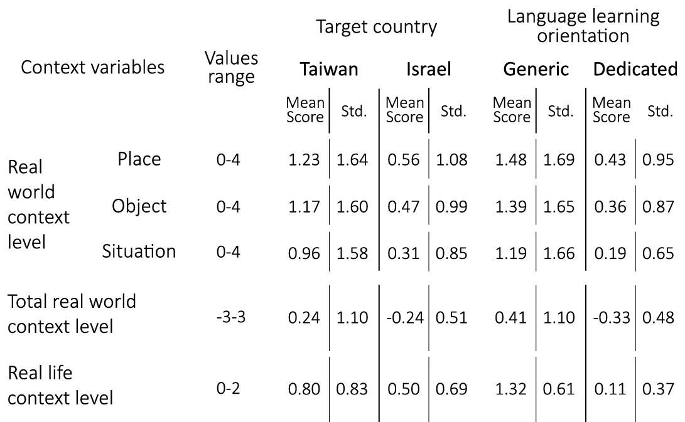
Findings – descriptive
Table 4. Contextualized MALL variables
1. Mean scores of standardized total real world context level and real life context level were all higher in Taiwan than in Israel and higher in generic activities than in dedicated activities
2. Dedicated mean scores all seemed very low when compared with the possible value ranges
12

Slide 17
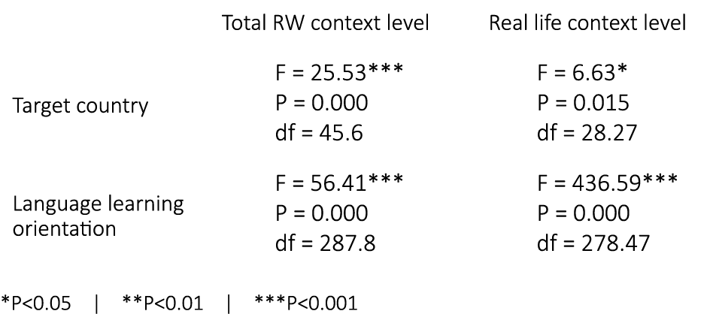
Findings – Q1 & Q2
What are the differences between target and non-target country in CMALL?
1
What are the differences between generic and dedicated language learning orientation in CMALL?
2
Table 5. Contextualized MALL – main effects
Target country effect is significant in total real world and real life context level
Language learning orientation effect is significant in total real world and real life context level
13

Slide 18
Findings – Q3
Are the differences between target and non-target country in CMALL a function of the generic and dedicated language learning orientation?
3
Table 6. Contextualized MALL – interaction effects
1. Interaction effect of the target country and language learning – significant in both total real world context level and real life context level
14

Slide 19
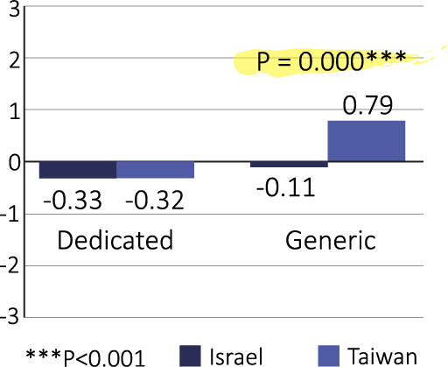
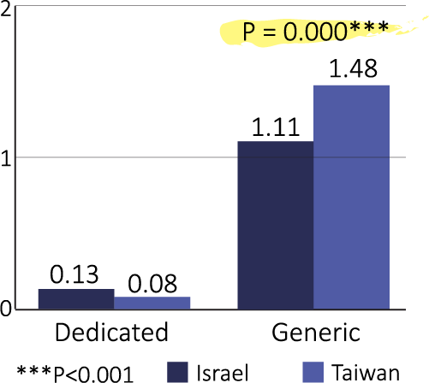
Findings – Q3
2. Follow-up Bonferroni simple effect comparisons of total real world context level and real life context level
Figure 2. Total real world context level – simple effects
Figure 3. Real life context level – simple effects
15

Slide 20
Findings – Q1, Q2 & Q3
Q1
Target country
Activities in Taiwan – higher real world, real life context level
Q2
Language learning orientation
Generic activities – higher real world, real life context level
Q3
Target country x Language learning orientation
Higher CMALL (real world context level and real life context level) between Taiwan and Israel, manifested only through generic activities
16

Slide 21
Discussion
Target country and language learning orientation
CMALL was significantly higher in the target country but only in generic activities
Generic differences, suggested explanations: English in social media in Israel, less in daily need for electronic dictionary in Israel
Dedicated similarly low in target and non-target, suggested factors: restricted content; lengthy content; content presentation; content affective engagement
18

Slide 22
Contribution
Practice
Target country and language learning orientation
In the target country, focus particularly on the dedicated activities. support from generic activities
In the non-target country, tackle both generic and dedicated activities. Support from generic usages of dictionary and social as available even in the non-target country and as shown in this study
Research
The findings contribute to missing data about definitions and relations among MALL constituents (Duman et al., 2015)
Quantitative and refined substantiation of existing literature concerning learning in target country (Anderson et al., 2008; Comas-Quinn et al., 2009; Petersen et al., 2008)
18

Slide 23
Limitations & future studies
Limitations:
296 activity types of 53 learners relatively small number of students
Future studies – using the RW/RL index:
Check more CMALL factors of influence )such as language proficiency)
19

Slide 24
Thank You!
谢谢
有问题吗？
20

Slide 25
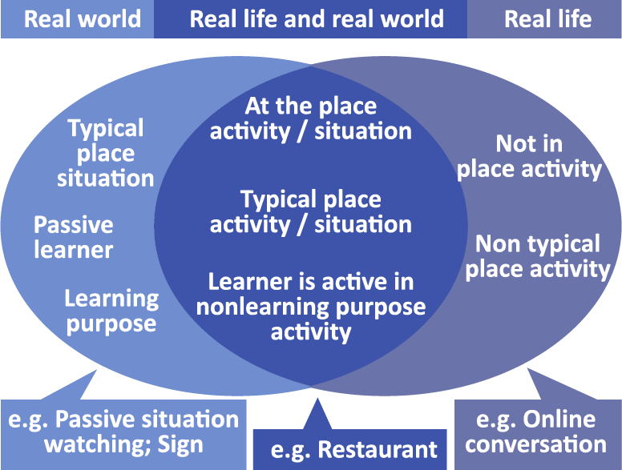
Findings – Q4
Figure 4. Real world and real life – commonalities and differences
17

